Slide 1
Software Project Management (Module 5)

Slide 2
Organization of this Lecture:
Introduction to Project Planning
Software Cost Estimation
  Cost Estimation Models
  Software Size Metrics
  Empirical Estimation
  Heuristic Estimation
  COCOMO
Staffing Level Estimation
Effect of Schedule Compression on Cost
Summary

Slide 3
Introduction
Many software projects fail:
  due to faulty project management practices:
    It is important to learn different aspects of software project management.

Slide 4
Introduction
Goal of software project management:
  enable a group of engineers to work efficiently towards successful completion of a software project.

Slide 5
Responsibility of project managers
Project proposal writing,
Project cost estimation,
Scheduling,
Project staffing,
Project monitoring and control,
Software configuration management,
Risk management,
Managerial report writing and presentations, etc.

Slide 6
Introduction
A project manager’s activities are varied.
  can be broadly classified into:
    project planning,
    project monitoring and control activities.

Slide 7
Project Planning
Once a project is found to be feasible,
  project managers undertake project planning.

Slide 8
Project Planning Activities
Estimation:
  Effort, cost, resource, and project duration
Project scheduling:
Staff organization:
  staffing plans
Risk handling:
  identification, analysis, and abatement procedures
Miscellaneous plans:
  quality assurance plan, configuration management plan, etc.

Slide 9
Project planning
Requires utmost care and attention --- commitments to unrealistic time and resource estimates result in:
  irritating delays.
  customer dissatisfaction
  adverse affect on team morale
    poor quality work
  project failure.

Slide 10
Sliding Window Planning
Involves project planning over several stages:
  protects managers from making big commitments too early.
  More information becomes available as project progresses.
    Facilitates accurate planning

Slide 11
SPMP Document
After planning is complete:
  Document the plans:
  in a Software Project Management Plan(SPMP) document.

Slide 12
Organization of SPMP Document
  Introduction (Objectives,Major Functions,Performance Issues,Management and Technical Constraints)
  Project Estimates (Historical Data,Estimation Techniques,Effort, Cost, and Project Duration Estimates)
  Project Resources Plan (People,Hardware and Software,Special Resources)
  Schedules (Work Breakdown Structure,Task Network, Gantt Chart Representation,PERT Chart Representation)
  Risk Management Plan (Risk Analysis,Risk Identification,Risk Estimation, Abatement Procedures)
  Project Tracking and Control Plan
  Miscellaneous Plans(Process Tailoring,Quality Assurance)

Slide 13
Software Cost Estimation
Determine size of the product.
From the size estimate,
  determine the effort needed.
From the effort estimate,
  determine project duration, and cost.

Slide 14
Software Cost Estimation
Effort Estimation
Cost Estimation
Size Estimation
Staffing Estimation
Duration Estimation
Scheduling

Slide 15
Software Cost Estimation
Three main approaches to estimation:
  Empirical
  Heuristic
  Analytical

Slide 16
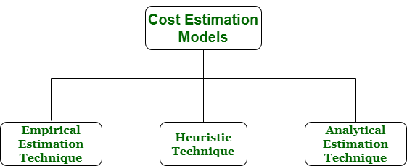
Software Cost Estimation Techniques
Empirical techniques:
  an educated guess based on past experience.
Heuristic techniques:
  assume that the characteristics to be estimated can be expressed in terms of
  some mathematical expression.
Analytical techniques:
  derive the required results starting from certain simple assumptions.

Slide 17
Software Size Metrics
LOC (Lines of Code):
  Simplest and most widely used metric.
  Comments and blank lines should not be counted.

Slide 18
Example
void selSort(int x[], int n) {
//Below function sorts an array in ascending order
int i, j, min, temp;
for (i = 0; i < n - 1; i++) {
min = i;
for (j = i + 1; j < n; j++)
if (x[j] < x[min])
min = j;
temp = x[i];
x[i] = x[min];
x[min] = temp;
}
}
So, now If LOC is simply a count of the numbers of lines then the above function shown contains 13 lines of code (LOC). But when comments and blank lines are ignored, the function shown above contains 12 lines of code (LOC).

Slide 19
Disadvantages of Using LOC
Size can vary with coding style.
Focuses on coding activity alone.
Correlates poorly with quality and efficiency of code.
Penalizes higher level programming languages, code reuse, etc.

Slide 20
Disadvantages of Using LOC (cont...)
Measures lexical/textual complexity only.
  does not address the issues of structural or logical complexity.
Difficult to estimate LOC from problem description.
  So not useful for project planning

Slide 21
Function Point Metric
Overcomes some of the shortcomings of the LOC metric
Proposed by Allan from IBM in early 80's:
  FP=4 #inputs + 5 #Outputs + 4 #inquiries + 10 #files + 10 #interfaces
Input:
  A set of related inputs is counted as one input.

Slide 22
Function Point Metric
Output:
  A set of related outputs is counted as one output.
Inquiries:
  Each user query type is counted.
Files:
  Files are logically related data and thus can be data structures or physical files.
Interface:
  Data transfer to other systems.

Slide 23
Function Point Metric (CONT.)
Suffers from a major drawback:
  the size of a function is considered to be independent of its complexity.
Extend function point metric:
  Feature Point metric:
  considers an extra parameter:
    Algorithm Complexity.

Slide 24
Function Point Metric (CONT.)
Proponents claim:
  FP is language independent.
  Size can be easily derived from problem description
Opponents claim:
  it is subjective --- Different people can come up with different estimates for the same problem.

Slide 25
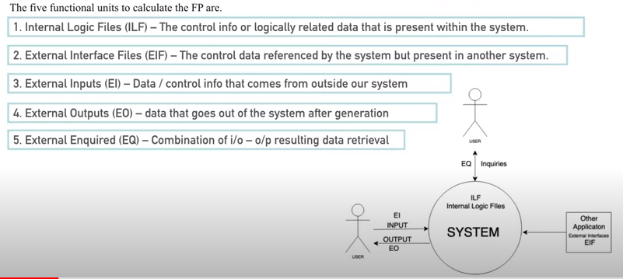
Calculation of Function Point

Slide 26
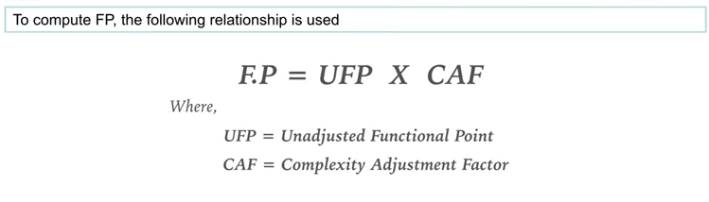
FP

Slide 27
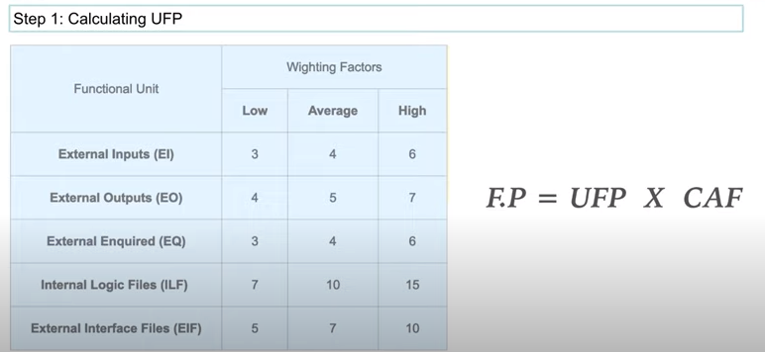
Step 1

Slide 28
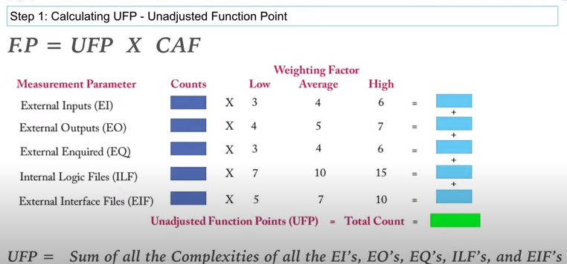
Step 1

Slide 29
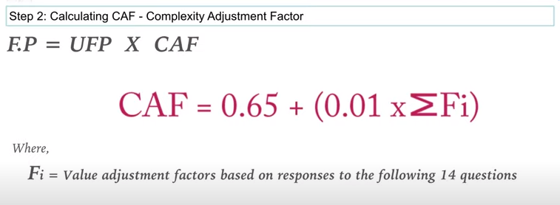
Step 2

Slide 30
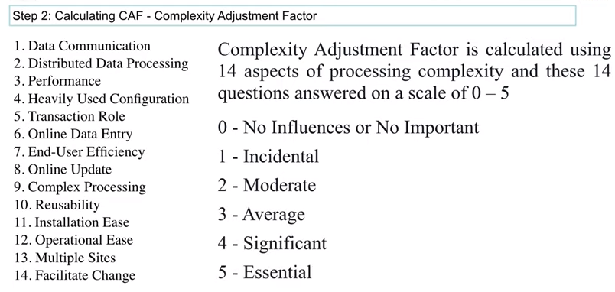
Step 2

Slide 31
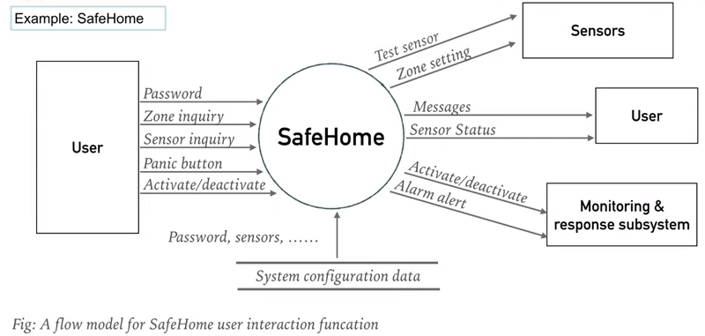
Example

Slide 32
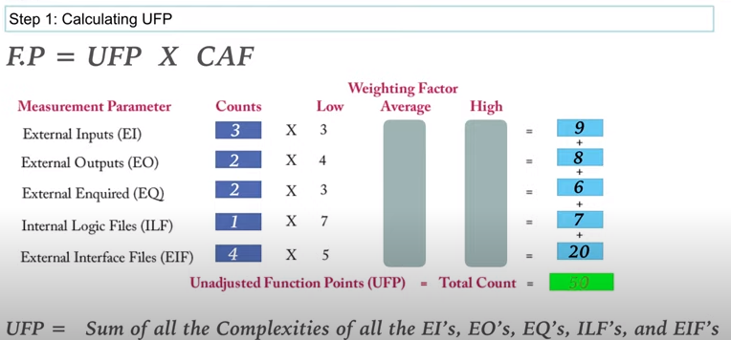
UFP

Slide 33
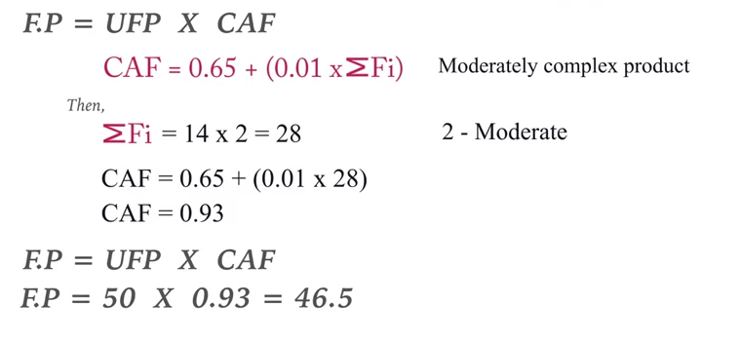
FP

Slide 34
Empirical Size Estimation Techniques
Expert Judgement:
  An euphemism for guess made by an expert.
  Suffers from individual bias.
Delphi Estimation:
  overcomes some of the problems of expert judgement.

Slide 35
Expert judgement
Experts divide a software product into component units:
  e.g. GUI, database module, data communication module, billing module, etc.
Add up the guesses for each of the components.

Slide 36
Delphi Estimation:
Team of Experts and a coordinator.
Experts carry out estimation independently:
  mention the rationale behind their estimation.
  coordinator notes down any extraordinary rationale:
    circulates among experts.

Slide 37
Delphi Estimation:
Experts re-estimate.
Experts never meet each other
  to discuss their viewpoints.

Slide 38
Heuristic Estimation Techniques
Single Variable Model:
  Parameter to be Estimated=C1(Estimated Characteristic)d1
Multivariable Model:
  Assumes that the parameter to be estimated depends on more than one characteristic.
  Parameter to be Estimated=C1(Estimated Characteristic)d1+ C2(Estimated Characteristic)d2+…
  Usually more accurate than single variable models.

Slide 39
COCOMO Model
COCOMO (COnstructive COst MOdel) proposed by Boehm.
Divides software product developments into 3 categories:
  Organic
  Semidetached
  Embedded

Slide 40
COCOMO Product classes
Roughly correspond to:
  application, utility and system programs respectively.
    Data processing and scientific programs are considered to be application programs.
    Compilers, linkers, editors, etc., are utility programs.
    Operating systems and real-time system programs, etc. are system programs.

Slide 41
Elaboration of Product classes
Organic:
  Relatively small groups
    working to develop well-understood applications.
Semidetached:
  Project team consists of a mixture of experienced and inexperienced staff.
Embedded:
  The software is strongly coupled to complex hardware, or real-time systems.

Slide 42
COCOMO Model (CONT.)
For each of the three product categories:
  From size estimation (in KLOC), Boehm provides equations to predict:
    project duration in months
    effort in programmer-months
Boehm obtained these equations:
  examined historical data collected from a large number of actual projects.

Slide 43
COCOMO Model (CONT.)
Software cost estimation is done through three stages:
  Basic COCOMO,
  Intermediate COCOMO,
  Complete COCOMO.

Slide 44
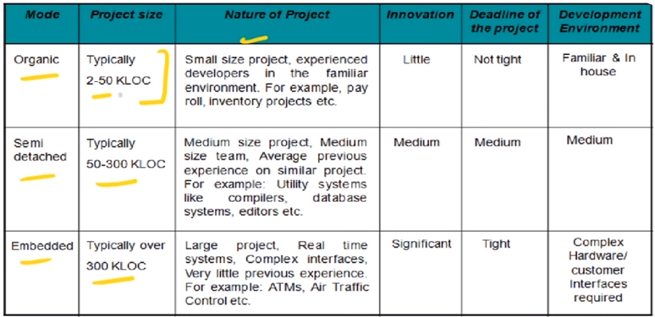
Project Size Classification

Slide 45
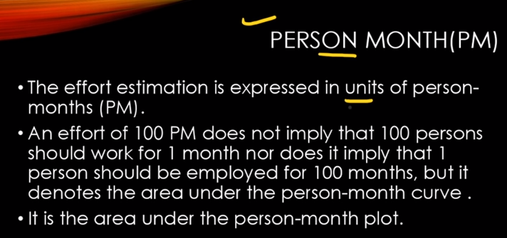
Person Month

Slide 46
Basic COCOMO Model (CONT.)
Gives only an approximate estimation:
  Effort = a1 (KLOC)^{a2}
  Tdev = b1 (Effort)^{b2}
    KLOC is the estimated kilo lines of source code,
    a1,a2,b1,b2 are constants for different categories of software products,
    Tdev is the estimated time to develop the software in months,
    Effort estimation is obtained in terms of person months (PMs).

Slide 47
Development Effort Estimation
Organic :
  Effort = 2.4 (KLOC)^{1.05} PM
Semi-detached:
  Effort = 3.0(KLOC)^{1.12} PM
Embedded:
  Effort = 3.6 (KLOC)^{1.20}PM

Slide 48
Development Time Estimation
Organic:
  Tdev = 2.5 (Effort)^{0.38} Months
Semi-detached:
  Tdev = 2.5 (Effort)^{0.35} Months
Embedded:
  Tdev = 2.5 (Effort)^{0.32} Months

Slide 49
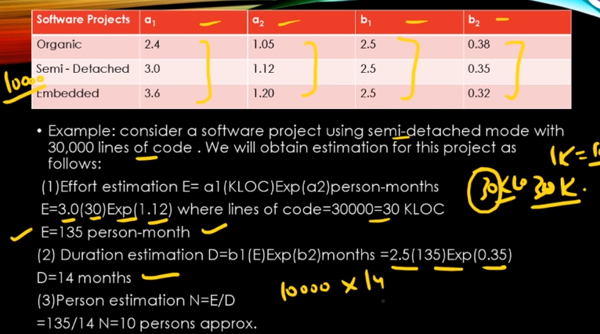
Case Study

Slide 50
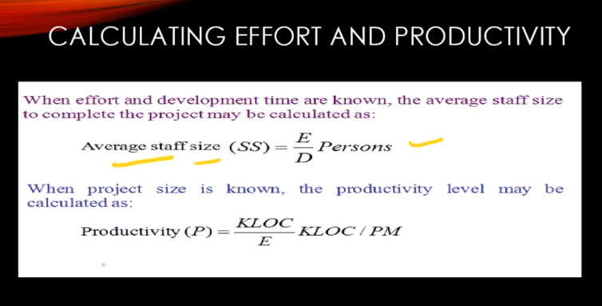
Cont..

Slide 51
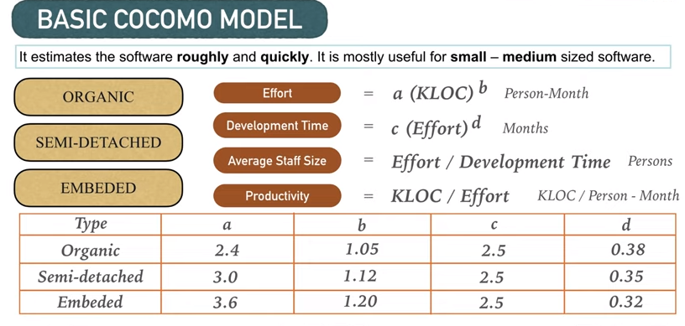
Basic

Slide 52
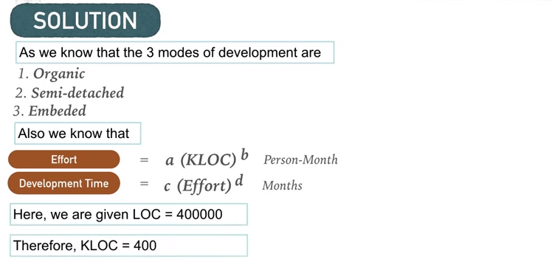
Solution

Slide 53
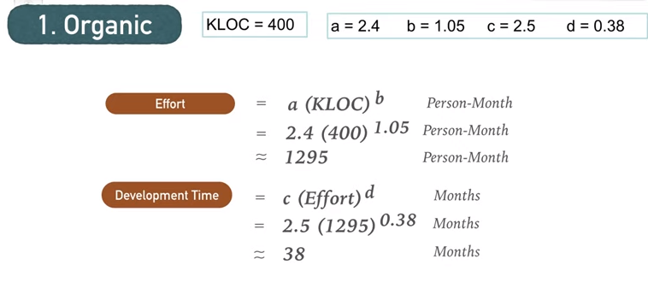
Organic

Slide 54
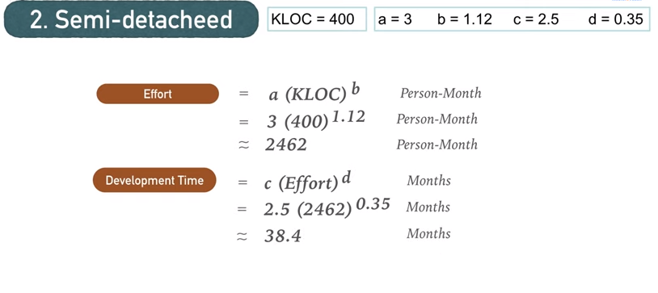
Semi-detached

Slide 55
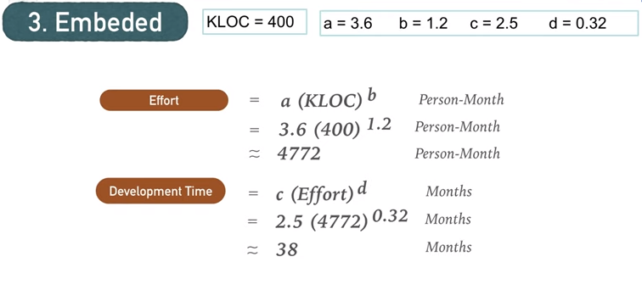
Embeded

Slide 56
Basic COCOMO Model (CONT.)
Effort is somewhat super-linear in problem size.
Semidetached
Effort
Embedded
Organic
Size

Slide 57
Basic COCOMO Model (CONT.)
Development time
  sublinear function of product size.
When product size increases two times,
  development time does not double.
Time taken:
  almost same for all the three product categories.
Dev. Time
Embedded
Semidetached
18 Months
14 Months
Organic
30K
60K
Size

Slide 58
Basic COCOMO Model (CONT.)
Development time does not increase linearly with product size:
  For larger products more parallel activities can be identified:
    can be carried out simultaneously by a number of engineers.

Slide 59
Basic COCOMO Model (CONT.)
Development time is roughly the same for all the three categories of products:
  For example, a 60 KLOC program can be developed in approximately 18 months
    regardless of whether it is of organic, semi-detached, or embedded type.
  There is more scope for parallel activities for system and application programs,
    than utility programs.

Slide 60
Example
The size of an organic software product has been estimated to be 32,000 lines of source code.
Effort = 2.4*(32)1.05 = 91 PM
Nominal development time = 2.5*(91)0.38 = 14 months

Slide 61
Intermediate COCOMO
Basic COCOMO model assumes
  effort and development time depend on product size alone.
However, several parameters affect effort and development time:
    Reliability requirements
    Availability of CASE tools and modern facilities to the developers
    Size of data to be handled

Slide 62
Intermediate COCOMO
For accurate estimation,
  the effect of all relevant parameters must be considered:
  Intermediate COCOMO model recognizes this fact:
    refines the initial estimate obtained by the basic COCOMO by using a set of 15 cost drivers (multipliers).

Slide 63
Intermediate COCOMO (CONT.)
If modern programming practices are used,
  initial estimates are scaled downwards.
If there are stringent reliability requirements on the product :
  initial estimate is scaled upwards.

Slide 64
Intermediate COCOMO (CONT.)
Rate different parameters on a scale of one to three:
  Depending on these ratings,
    multiply cost driver values with the estimate obtained using the basic COCOMO.

Slide 65
Intermediate COCOMO (CONT.)
Cost driver classes:
  Product: Inherent complexity of the product, reliability requirements of the product, etc.
  Computer: Execution time, storage requirements, etc.
  Personnel: Experience of personnel, etc.
  Development Environment: Sophistication of the tools used for software development.

Slide 66
These cost drivers can be classified under-
Product attributes
  size of the application’s database
  the complexity of the product
  software’s reliability extent
Hardware attributes
  Total turnabout time
  Memory constraints
  Run-time performance constraints
Project attributes
  software tools used
  required development schedule
Personnel attributes
  Applications experience
  Coding experience
  Software developer’s capability
  Analyst experience

Slide 67
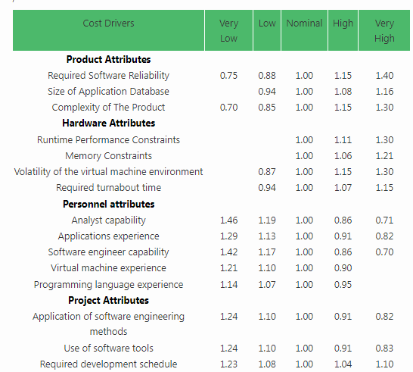
Table for Cost drivers

Slide 68
Effort Calculation:
The project manager is to rate these 15 different parameters for a particular project on a scale of one to three. Then, depending on these ratings, appropriate cost driver values are taken from the above table. These 15 values are then multiplied to calculate the EAF (Effort Adjustment Factor).

Slide 69
Table :
The values of a and b in case of the intermediate model are as follows:
Software Projects | a | b
Organic | 3.2 | 1.05
Semi Detached | 3.0 | 1.12
Embeddedc | 2.8 | 1.20

Slide 70
Shortcoming of basic and intermediate COCOMO models
Both models:
  consider a software product as a single homogeneous entity:
  However, most large systems are made up of several smaller sub-systems.
    Some sub-systems may be considered as organic type, some may be considered embedded, etc.
    for some the reliability requirements may be high, and so on.

Slide 71
Complete COCOMO
Cost of each sub-system is estimated separately.
Costs of the sub-systems are added to obtain total cost.
Reduces the margin of error in the final estimate.

Slide 72
Complete COCOMO Example
A Management Information System (MIS) for an organization having offices at several places across the country:
  Database part (semi-detached)
  Graphical User Interface (GUI) part (organic)
  Communication part (embedded)
Costs of the components are estimated separately:
  summed up to give the overall cost of the system.

Slide 73
Organization Structure
Functional Organization:
  Engineers are organized into functional groups, e.g.
    specification, design, coding, testing, maintenance, etc.
  Engineers from functional groups get assigned to different projects

Slide 74
Advantages of Functional Organization
Specialization
Ease of staffing
Good documentation is produced
  different phases are carried out by different teams of engineers.
Helps identify errors earlier.

Slide 75
Project Organization
Engineers get assigned to a project for the entire duration of the project
  Same set of engineers carry out all the phases
Advantages:
  Engineers save time on learning details of every project.
  Leads to job rotation

Slide 76
Team Structure
Problems of different complexities and sizes require different team structures:
  Chief-programmer team
  Democratic team
  Mixed organization

Slide 77
Democratic Teams
Suitable for:
  small projects requiring less than five or six engineers
  research-oriented projects
A manager provides administrative leadership:
  at different times different members of the group provide technical leadership.

Slide 78
Democratic Teams
Democratic organization provides
  higher morale and job satisfaction to the engineers
  therefore leads to less employee turnover.
Suitable for less understood problems,
  a group of engineers can invent better solutions than a single individual.

Slide 79
Democratic Teams
Disadvantage:
  team members may waste a lot time arguing about trivial points:
    absence of any authority in the team.

Slide 80
Chief Programmer Team
A senior engineer provides technical leadership:
  partitions the task among the team members.
  verifies and integrates the products developed by the members.

Slide 81
Chief Programmer Team
Works well when
  the task is well understood
    also within the intellectual grasp of a single individual,
  importance of early completion outweighs other factors
    team morale, personal development, etc.

Slide 82
Chief Programmer Team
Chief programmer team is subject to single point failure:
  too much responsibility and authority is assigned to the chief programmer.

Slide 83
Mixed Control Team Organization
Draws upon ideas from both:
  democratic organization and
  chief-programmer team organization.
Communication is limited
  to a small group that is most likely to benefit from it.
Suitable for large organizations.

Slide 84
Team Organization
Democratic Team
Chief Programmer team

Slide 85
Mixed team organization

Slide 86
Summary
We discussed the broad responsibilities of the project manager:
  Project planning
  Project Monitoring and Control

Slide 87
Summary
To estimate software cost:
  Determine size of the product.
  Using size estimate,
    determine effort needed.
  From the effort estimate,
    determine project duration, and cost.

Slide 88
Summary (CONT.)
Cost estimation techniques:
  Empirical Techniques
  Heuristic Techniques
  Analytical Techniques
Empirical techniques:
  based on systematic guesses by experts.
    Expert Judgement
    Delphi Estimation

Slide 89
Summary (CONT.)
Heuristic techniques:
  assume that characteristics of a software product can be modeled by a mathematical expression.
  COCOMO
Analytical techniques:
  derive the estimates starting with some basic assumptions:
  Halstead's Software Science

Slide 90
Summary (CONT.)
The staffing level during the life cycle of a software product development:
  follows Rayleigh curve
  maximum number of engineers required during testing.

Slide 91
Summary (CONT.)
Relationship between schedule change and effort:
  highly nonlinear.
Software organizations are usually organized in:
  functional format
  project format

Slide 92
Summary (CONT.)
Project teams can be organized in following ways:
  Chief programmer: suitable for routine work.
  Democratic: Small teams doing R&D type work
  Mixed: Large projects

